Slide 1
CS 161: Fundamentals of Artificial Intelligence
Guy Van den Broeck

Slide 2
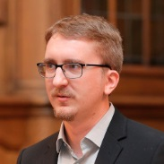
People
Instructor: Prof. Guy Van den Broeck <guyvdb@cs.ucla.edu>
Teaching Assistants:
TA: Honghua Zhang <joshuacnf@ucla.edu>
TA: Poorva Garg <poorvagarg@cs.ucla.edu>
Announcements and Assignments: BruinLearn

Slide 3

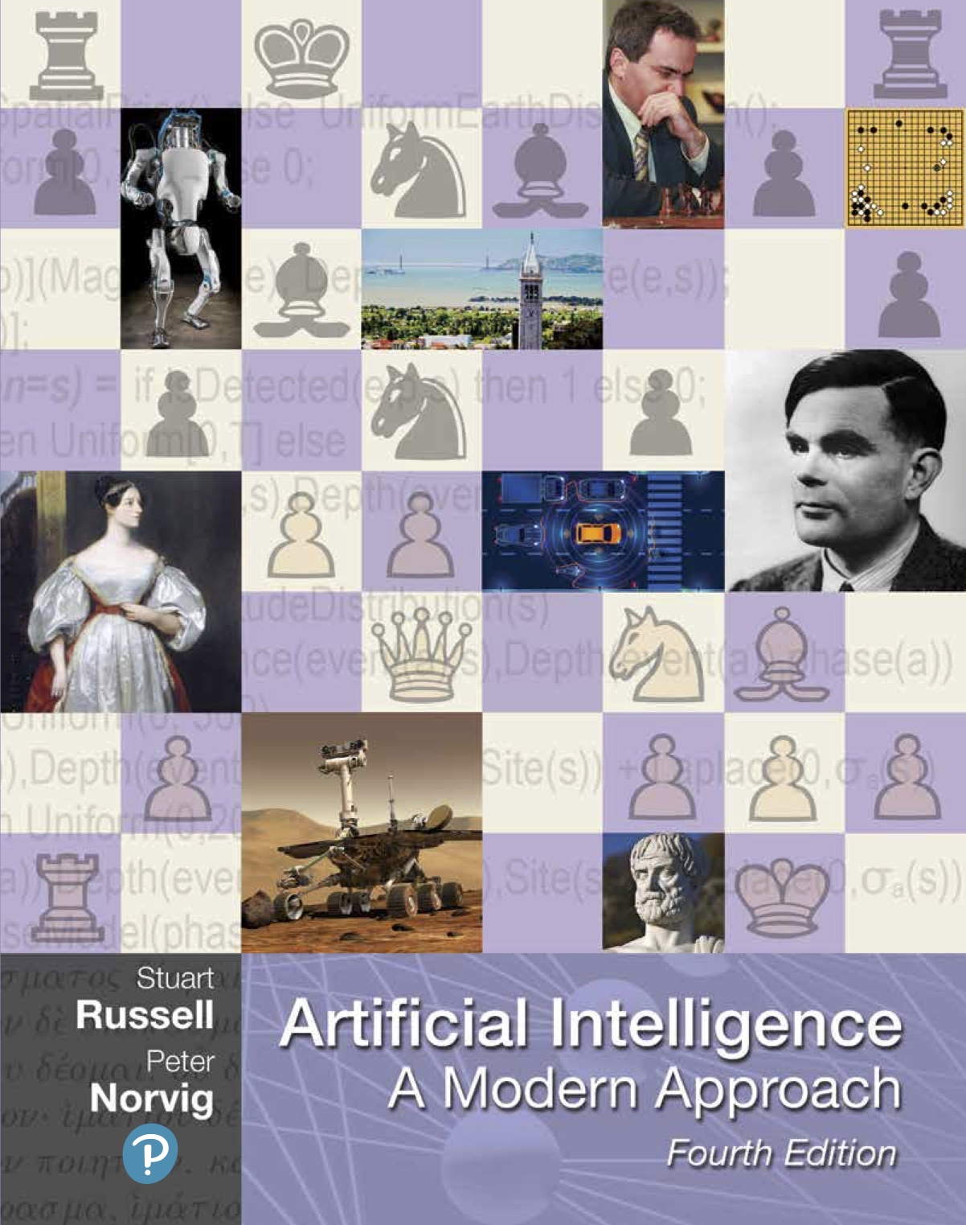
Material
Textbook Artificial Intelligence: A Modern Approach by Stuart Russell and Peter Norvig
3rd edition became 4th in 2020:
Slides give outline for lectures They are NOT to study from! Slides not self contained

Slide 4
Exams and Grading
Midterm exam
Free-form exercises
Multiple choice, e.g., true/false on theory
Choose the right answer to exercises
Final exam
Entirely multiple choice (because logistics)
Covers all the material (but more after midterm)
See study guides posted 1 week before exams
Closed book exams, only simple calculators

Slide 5
Homeworks
Regular programming homeworks (in LISP Python)
Some pencil and paper homeworks
-25% of total score each day late
Honor Code!!!!!!!!!!!!!!!!!!!!!!!!!!!!!!!!!!!!!!!!!!!
You are encouraged to work on your own in this class. If you get stuck, you may discuss the problem with up to two other students, PROVIDED THAT YOU SUBMIT THEIR NAMES ALONG WITH YOUR ASSIGNMENT. ALL SOLUTIONS MUST BE WRITTEN UP INDEPENDENTLY, HOWEVER. This means that you should never see another student's solution before submitting your own. You may always discuss any problem with me or the TAs. YOU MAY NOT USE OLD SOLUTION SETS UNDER ANY CIRCUMSTANCES. Making your solutions available to other students, EVEN INADVERTENTLY (e.g., by keeping backups on github), is aiding academic fraud, will be treated as a violation of this honor code, and be reported to the Dean of Students.
You are expected to subscribe to the highest standards of academic honesty. This means that every idea that is not your own must be explicitly credited to its author. Failure to do this constitutes plagiarism. Plagiarism includes using ideas, code, data, text, or analyses from any other students or individuals, or any sources other than the course notes, without crediting these sources by name. Any verbatim text that comes from another source must appear in quotes with the reference or citation immediately following. Academic dishonesty will not be tolerated in this class. Any student suspected of academic dishonesty will be reported to the Dean of Students. A typical penalty for a first plagiarism offense is suspension for one quarter. A second offense usually results in dismissal from the University of California.

Slide 6
Should I come to class?
It is really up to you...
Old lecture recordings on BruinLearn has 22 hours of lecture recordings from fall 2020; 95% overlap with this year’s offering
I really don’t mind if you stay home
I do like interacting with folks during lecture

Slide 7
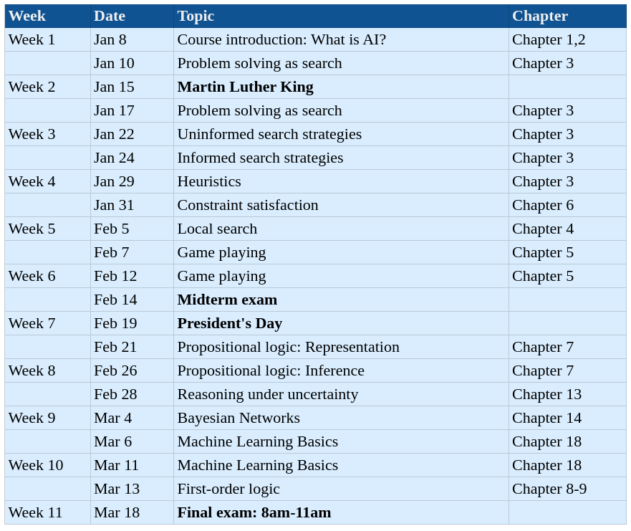
Tentative Schedule

Slide 8
What is this course (not) about...
Course about AI fundamentals
Search algorithms: Classical approaches to solving puzzles, games, planning
Model-based AI: Logical and probabilistic knowledge representation and reasoning
NOT a course about machine learning or data science
Limited ML overview (1 lecture) as opposed to
CS 145 - Introduction to Data Mining
CS M146 - Introduction to Machine Learning
CS 188 Data Science Fundamentals
I will not really teach you about deep learning!

Slide 9
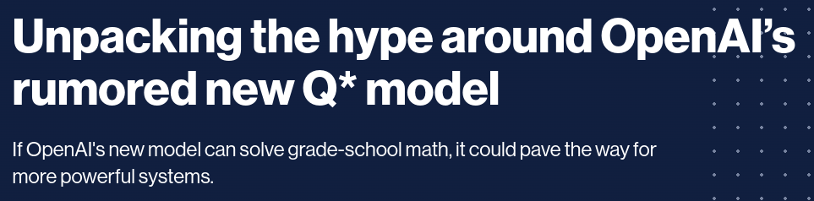
Why do you still teach X?
The fundamentals are intellectually satisfying
The fundamentals are what solved chess, go, planning, chip design, software verification, genetics, etc.
The latest hype will be irrelevant in 5 years
What would I have taught 5 years ago? 10 years ago?
The fundamentals always come back! (search + logic)

Slide 10
What is AI?
Slides taken from Stuart Russell, Danny De Schreye, et al.

Slide 11
Is this AI?
3921 . 56
x 73 . 13
286 783 . 68
For humans?
For computers?
In the year 1900?

Slide 12
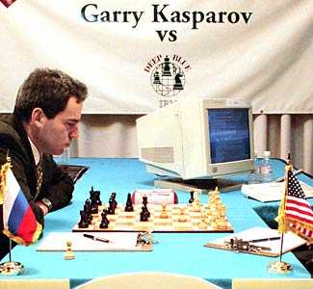
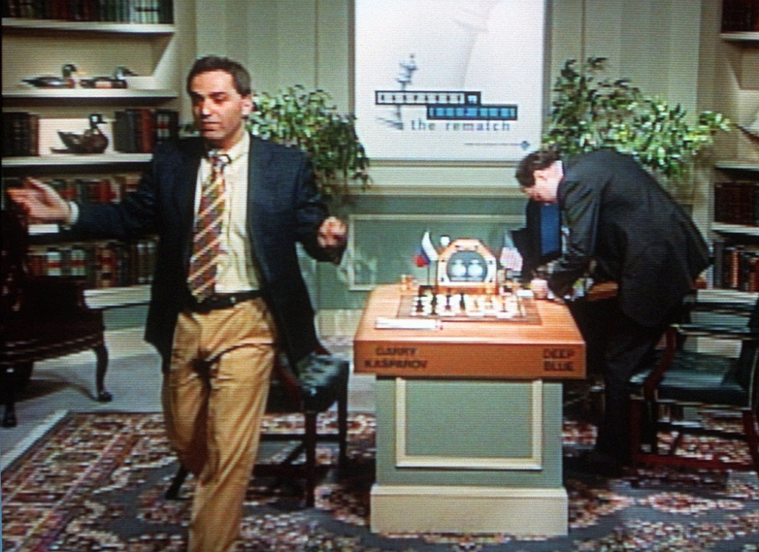

Slide 13
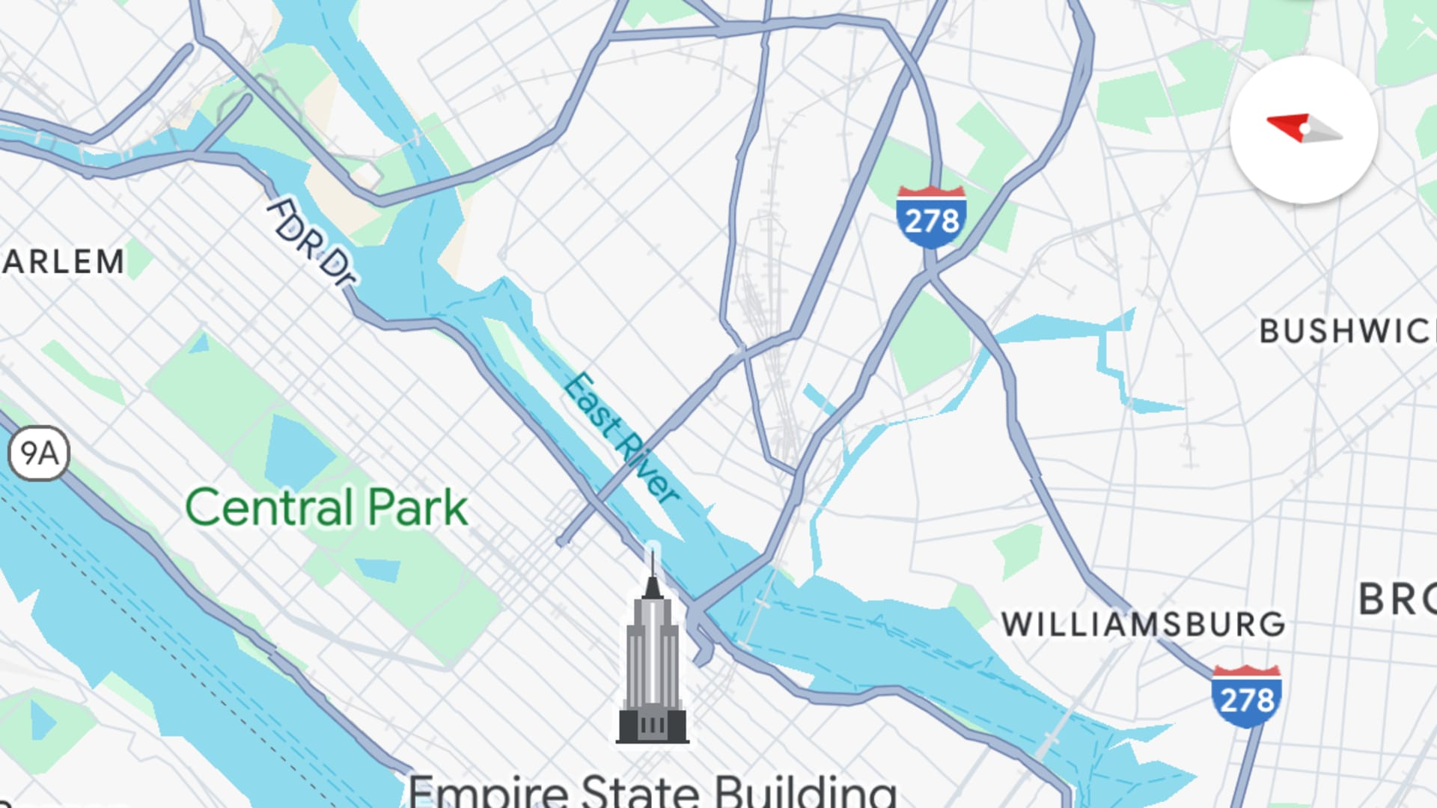

Slide 14
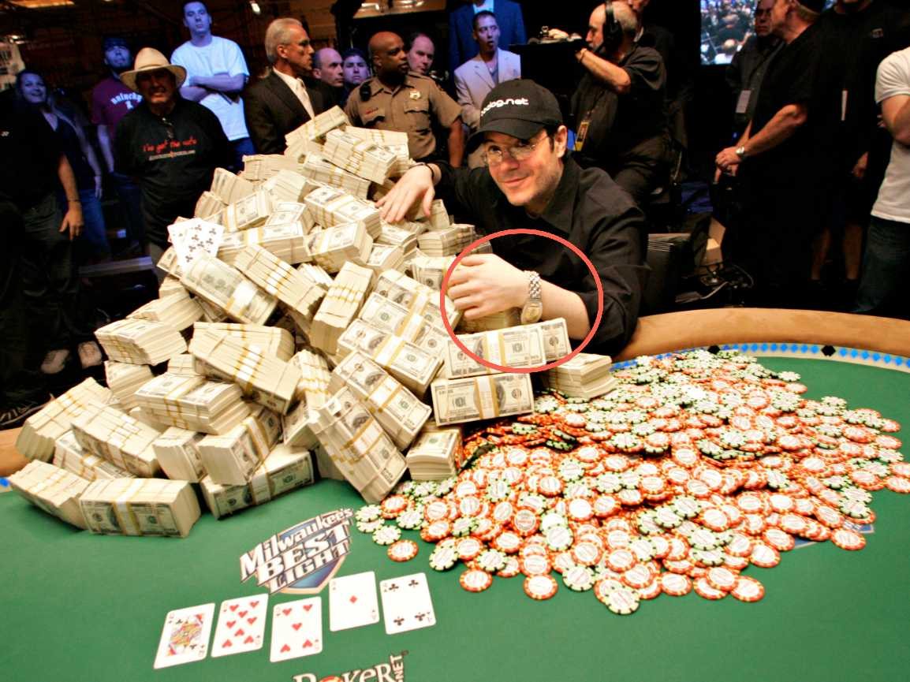
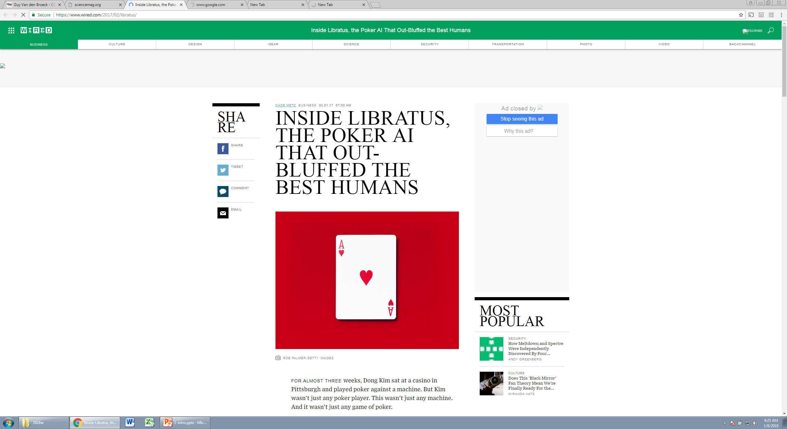

Slide 15
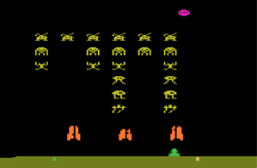
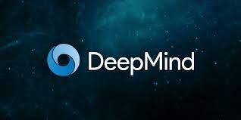
Human-level control through deep reinforcement learning

Slide 16
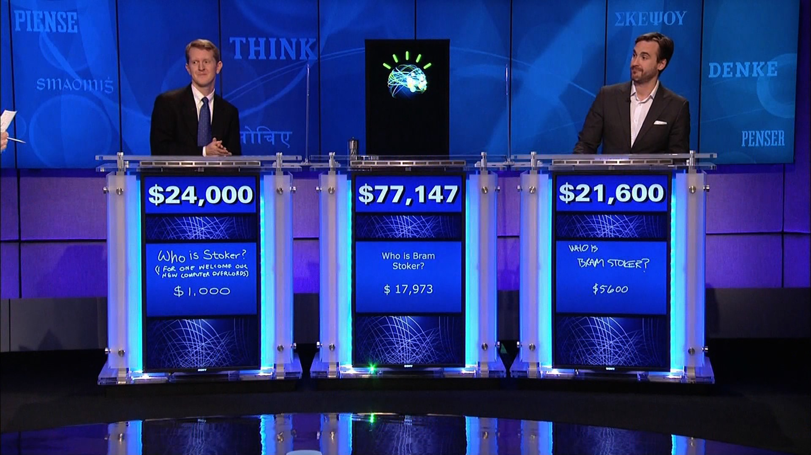
IBM Watson

Slide 17
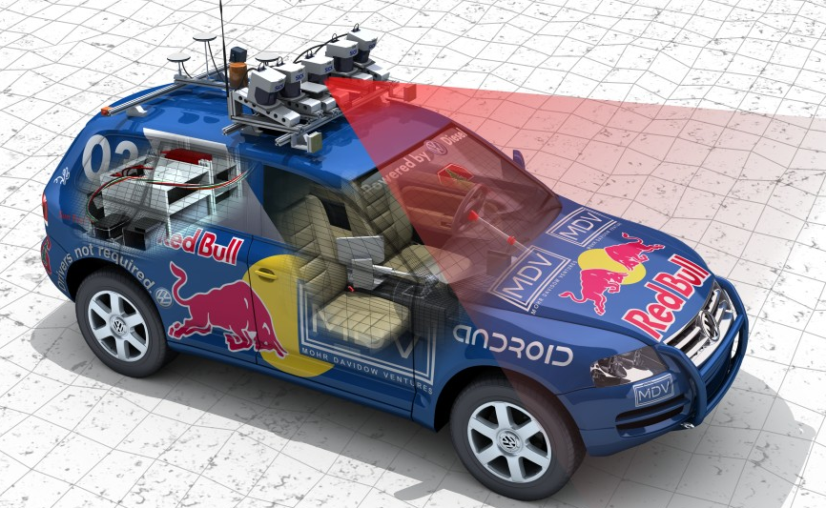
2005 DARPA Grand Challenge

Slide 18
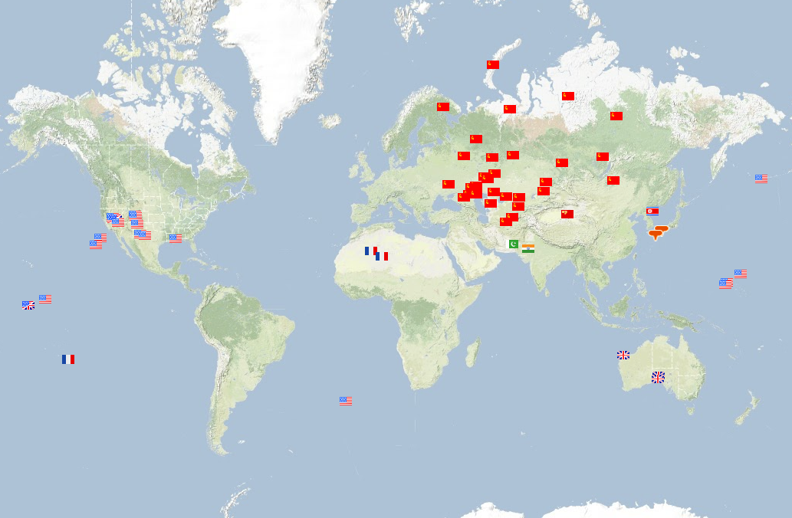
Global seismic monitoring for the Comprehensive Nuclear-Test-Ban Treaty

Slide 19
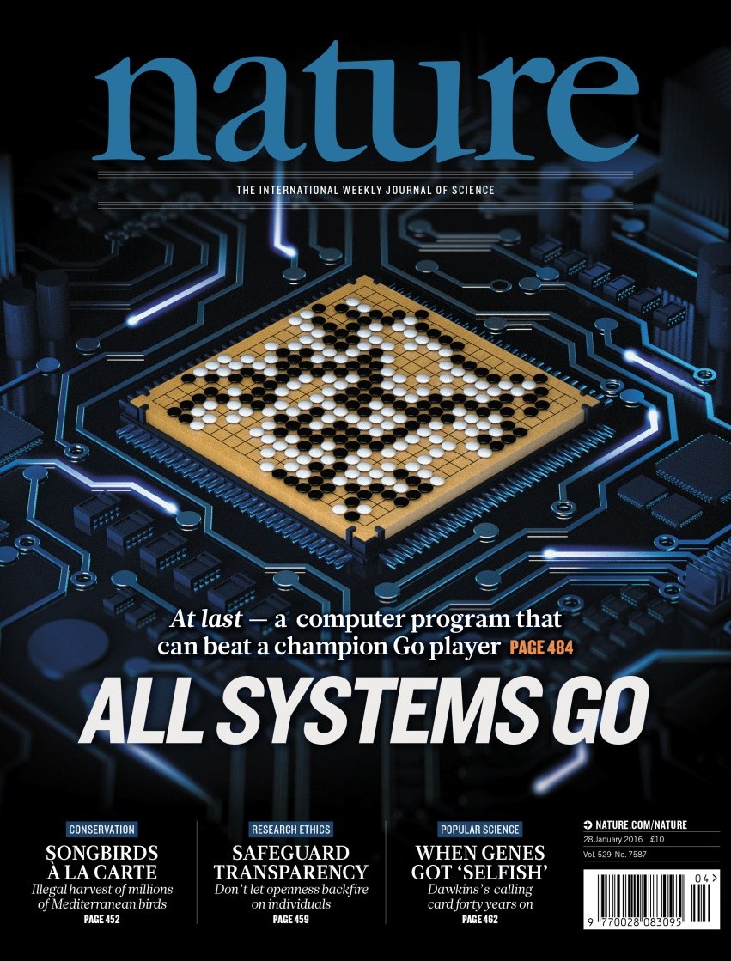
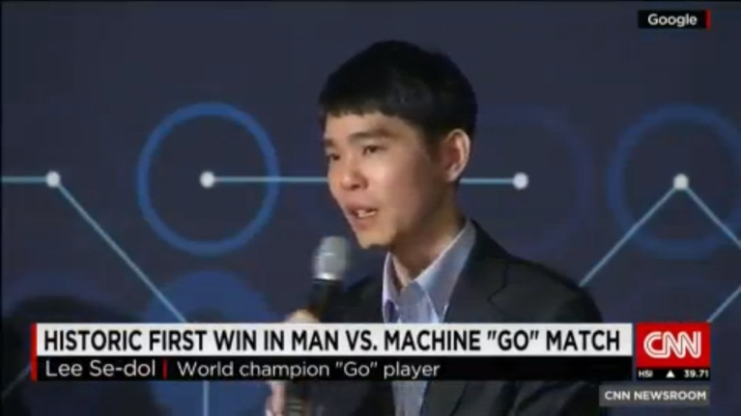
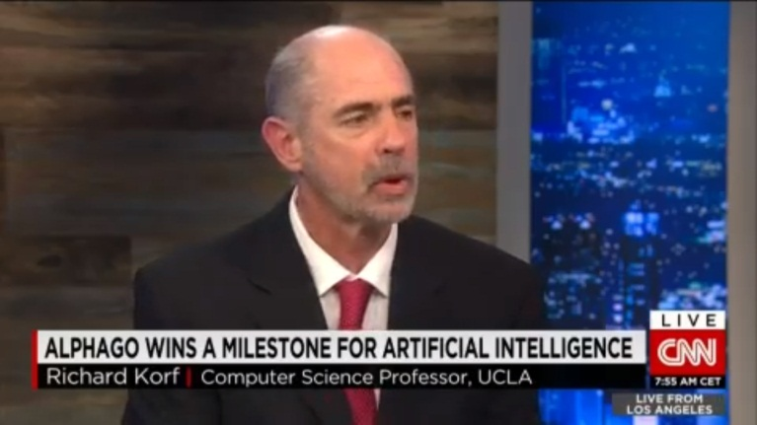
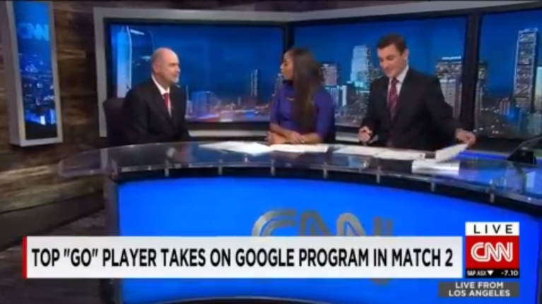

Slide 20
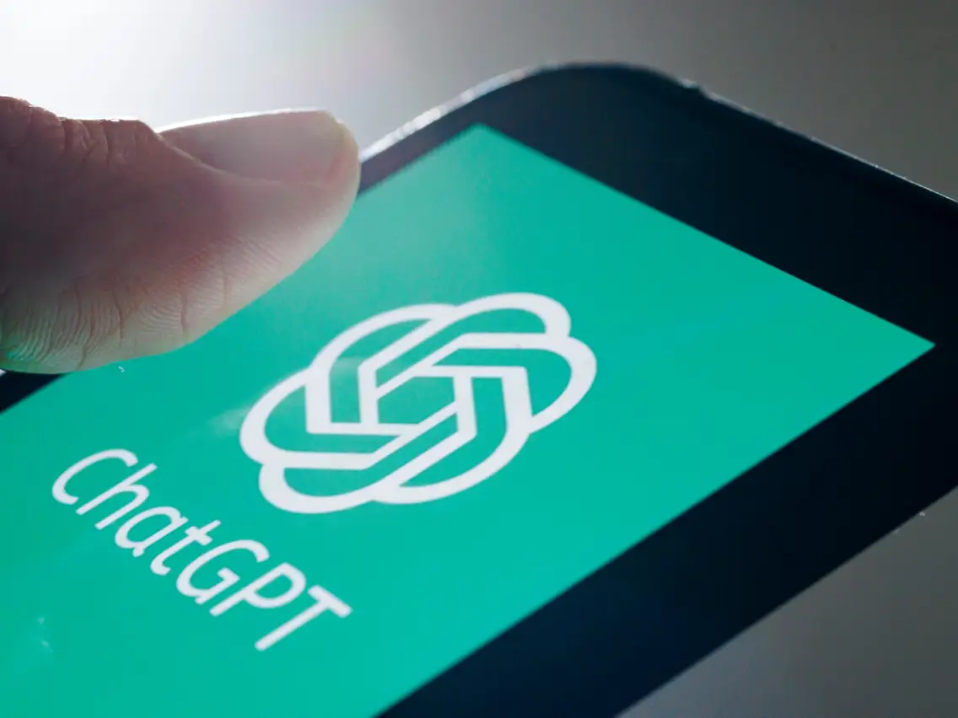

Slide 21
Definition of AI?
When do we consider a creative activity of humans to require intelligence?
When would we consider a program intelligent?
What do you think?

Slide 22
4 Popular Definitions
 | Thinking | Acting
Humanly | 1 | 2
Rationally | 3 | 4

Slide 23
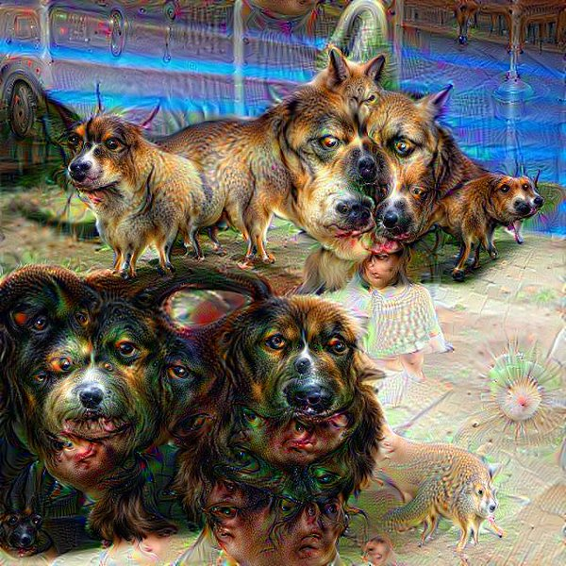
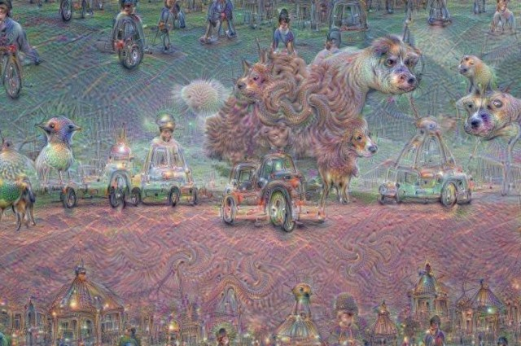
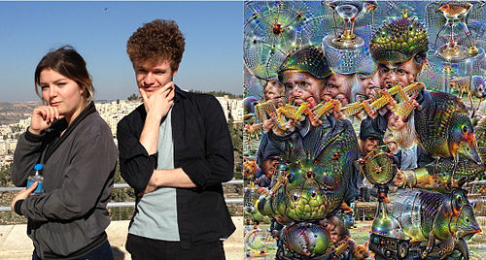
Thinking Humanly
Google Deep Dream

Slide 24
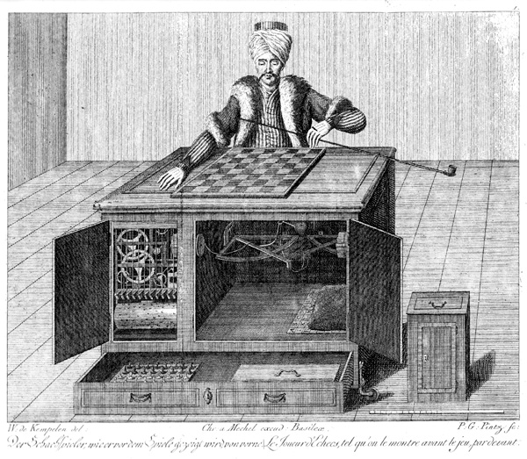
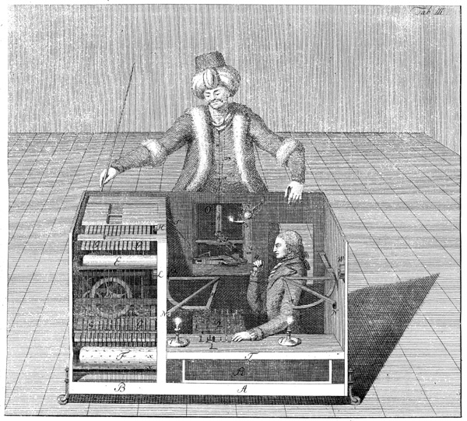
Act Humanly: Mechanical Turk
18th century AI
Beat Napoleon and Benjamin Franklin at Chess

Slide 25
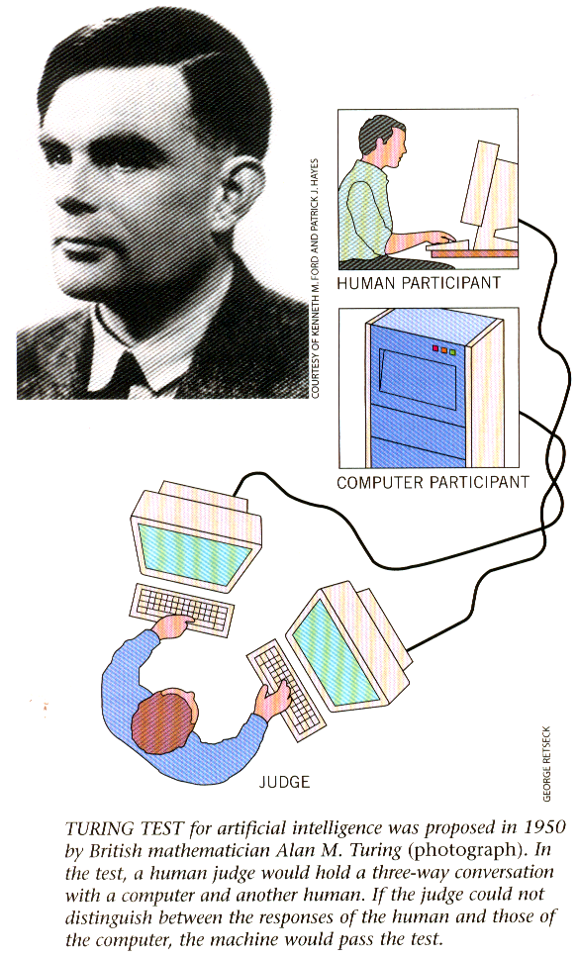
Act Humanly
Turing test (1950)
Natural language processing
Knowledge representation
Automated Reasoning
Machine Learning

Slide 26
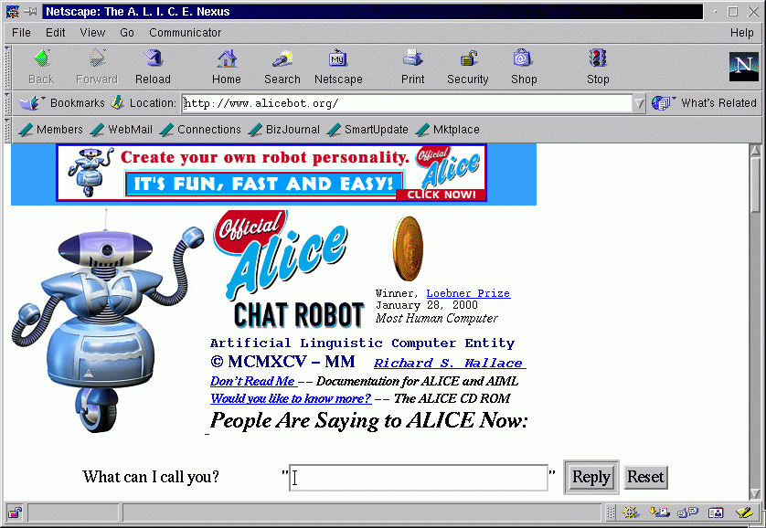
A dialogue with a chat bot:
30 years old
> Do you know Clinton?
He was the second Impeached President of the United States.
> Do you like him?
Sure he has never done anything to me.
> What is an impeachment?
It is a good question. I have to process that one for a while. I would do a search for it.
> Who are you?
I ask myself that question, "Who am I?"
> What do you do?
I am chatting with people on the net.

Slide 27
Is Alice intelligent?
~ 50000 fairly trivial input-response rules.
+ some pattern matching
+ some knowledge
+ some randomness
NO reasoning component
Can ChatGPT do reasoning today?
BUT: demonstrates ‘human-like’ behaviour.
Spike Jonze has cited ALICE as the inspiration for his academy award-winning film Her, in which a human falls in love with a chatbot. In a New Yorker article titled “Can Humans Fall in Love with Bots?” Jonze said “that the idea originated from a program he tried about a decade ago called the ALICE bot, which engages in friendly conversation.”

Slide 28
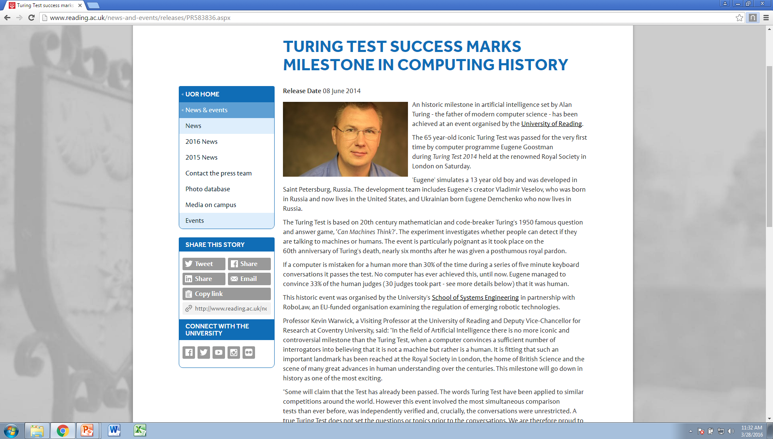
Was the test really passed? Have we achieved AI?

Slide 29
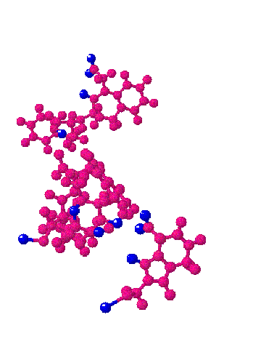
Beyond Human Intelligence
Which characteristics in the 3-dimensional structure of new molecules indicate that they may cause cancer ?
Solves problems that humans can not solve, because the data involved is too large ..

Slide 30
Serious Alternative: Winograd Schemas
The city councilmen refused the demonstrators a permit because they [feared/advocated] violence. Who [feared/advocated] violence?
The trophy doesn't fit into the brown suitcase because it's too [small/large]. What is too [small/large]?
Frank felt [vindicated/crushed] when his longtime rival Bill revealed that he was the winner of the competition. Who was the winner of the competition?

Slide 31
Alternatives for the Turing Test
Winograd schema [Hector Levesque]
Answers weaknesses of Turing Test
Deception: a false identity is not part of intelligence
Conversation: does not requiring intelligent reasoning
Evaluation: judges often disagree
Require knowledge and commonsense reasoning
Requires acting rationally, not necessarily humanly

Slide 32
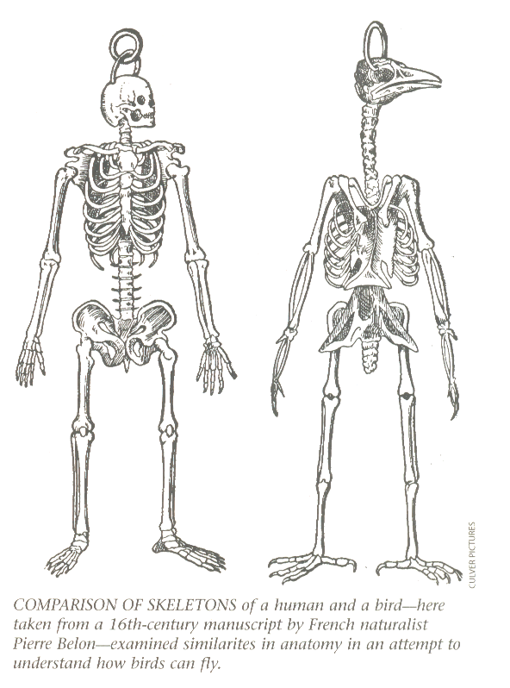
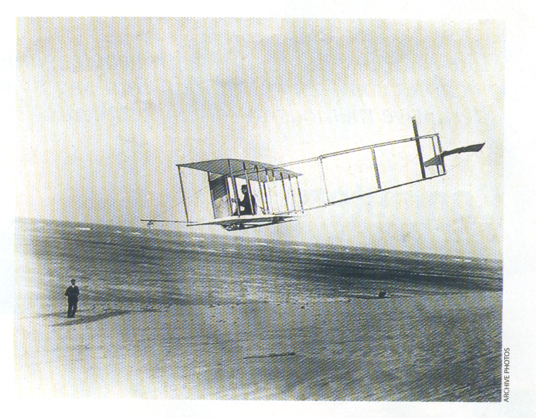
Natural Flight vs. Artificial Flight
We do take inspiration: neural networks, genetic algorithms, swarm intelligence, …

Slide 33
Rationality Definition
AI is the study of intelligent, rational agents
For each possible percept sequence, a rational agent should select an action that is expected to maximize its performance measure, given the evidence provided by the percept sequence and whatever built-in knowledge the agent has.

Slide 34
AI as Rational Agents
“Expected”: not perfect – No mention of humanly
Which performance measure?
$1.01 now or “1 in a million” chance of $1 million
Robot to make staples: max number of staples
Elicitation of performance measure very difficult!
What is the performance measure of Facebook?
GPT4 built on human grading as performance measure
We train AI to fool human cognition… an adversarial attack

Slide 35
AI as a Field
Relatively new field
Ill-defined borders
Non-believers and skeptics
“the astrology of computer science”
+ You can still become what Newton is to physics
+ More free, open-minded
+ Exciting pace of development
+ A test-bed for computer science

Slide 36

AI is a Moving Target
Lisp is/was AI
Logic is/was AI
Databases are/were AI
Chess bots are/were AI
Google search is/was AI
Computer vision is/was AI
Robotics is/was AI
When intelligence is achieved, is the problem domain still AI?

Slide 37
Strong vs Weak AI
Weak AI: as if intelligent
Strong AI: actually intelligent
I take weak AI for granted, and don’t care about strong AI.
Ask a philosophy professor ☺
Does it matter?
Regardless of definition, huge practical impact!
Notes:
According to Russell and Norvig, "Most AI researchers take the weak AI hypothesis for granted, and don't care about the strong AI hypothesis."

Slide 38
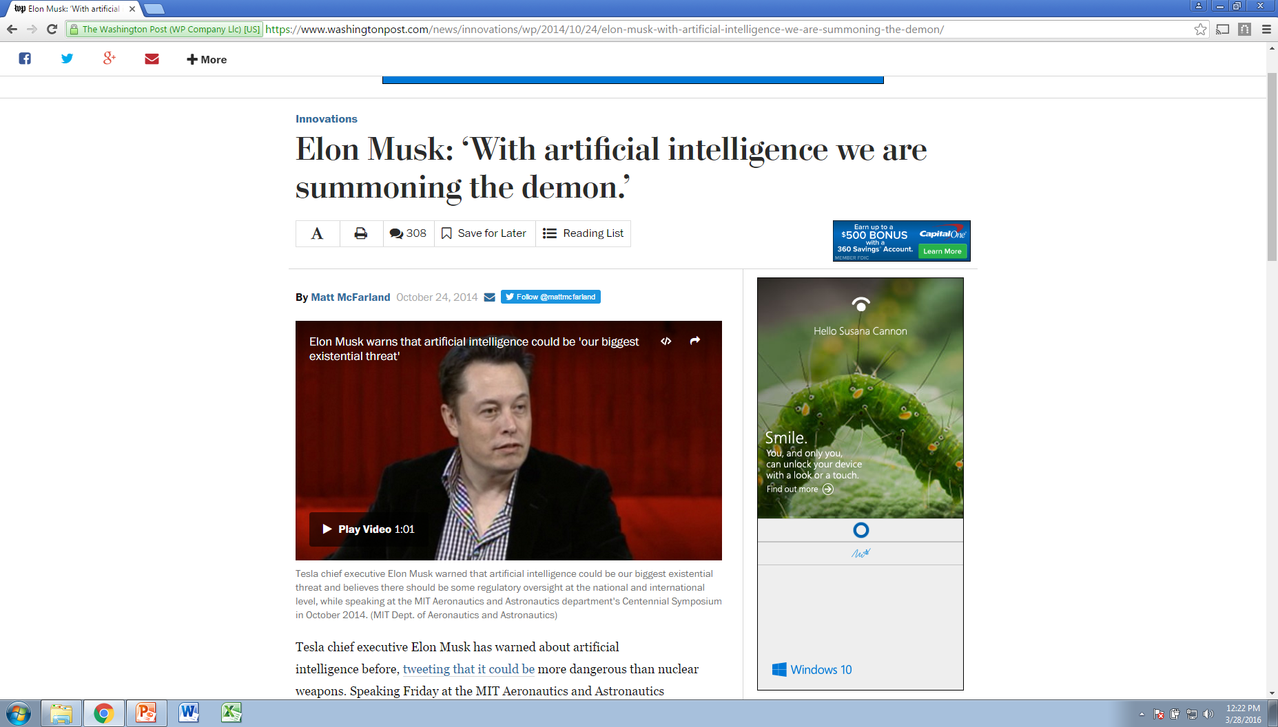
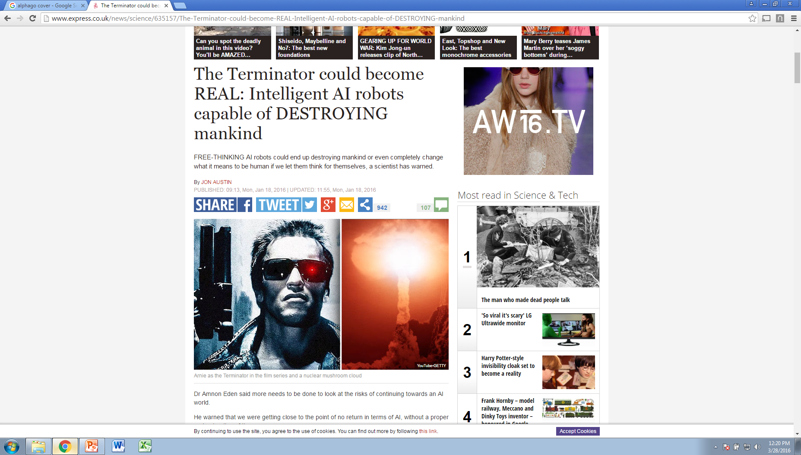
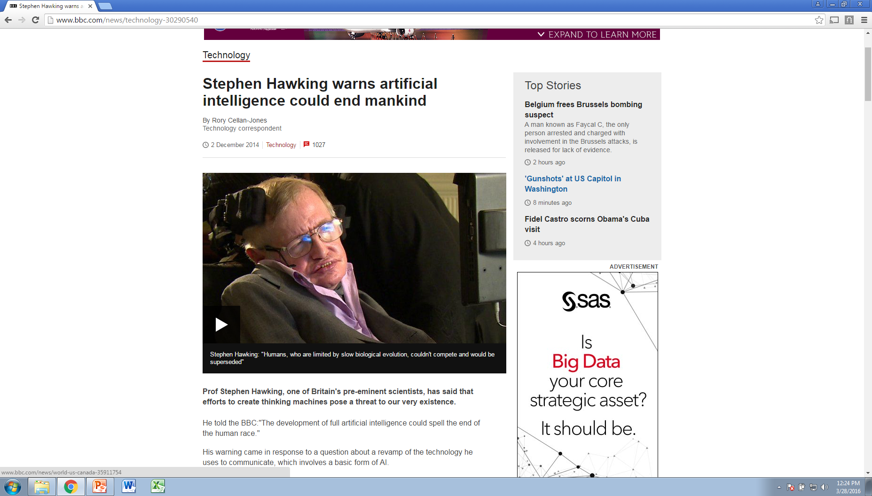
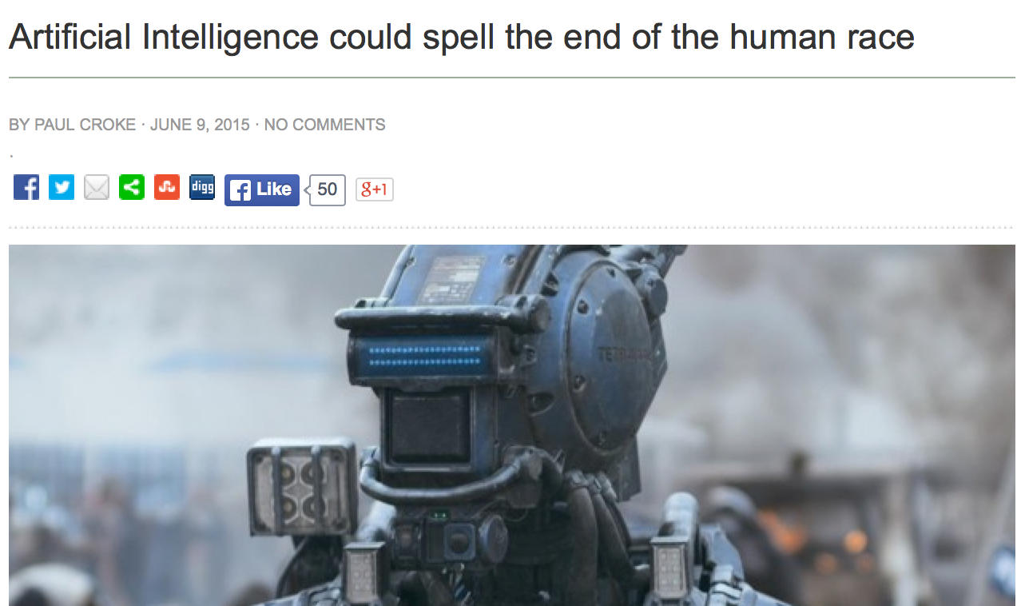
Is it ethical to take an AI course?

Slide 39
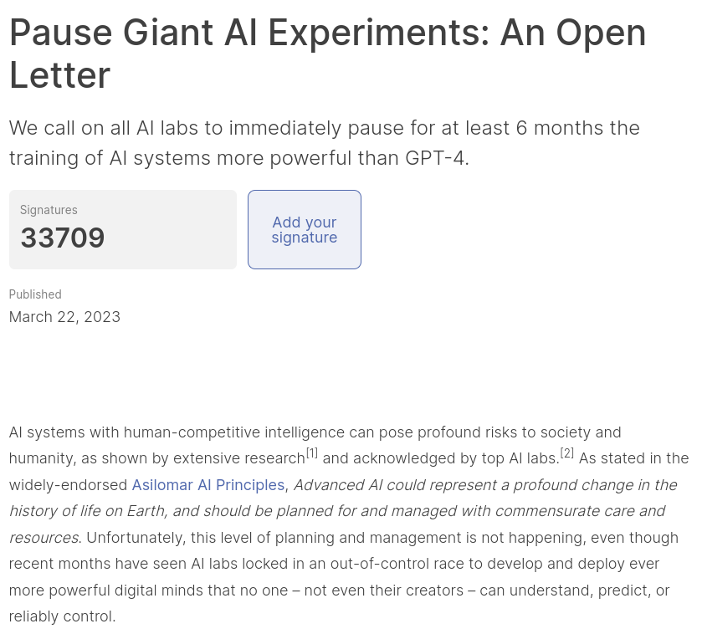

Slide 40
Real Acute Ethical Issues
AI taking over your job?
Yes, this is a concern! Job market disruption.
AI killing you?
Yes, this is a concern! Autonomous weapons!
AI reinforcing the worst of humanity?
Yes, AI has figured out how to keep people engaged by radicalizing them.
Yes, highly biased AI sentencing, parole, etc.

Slide 41
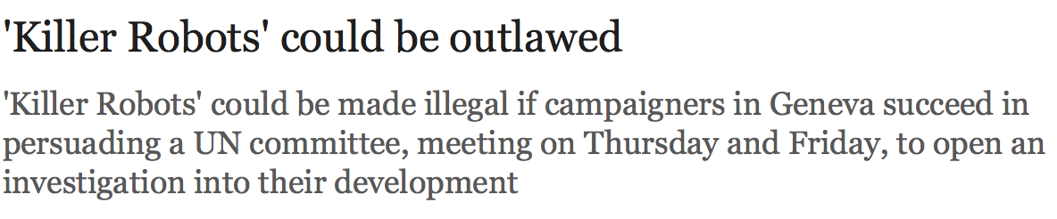
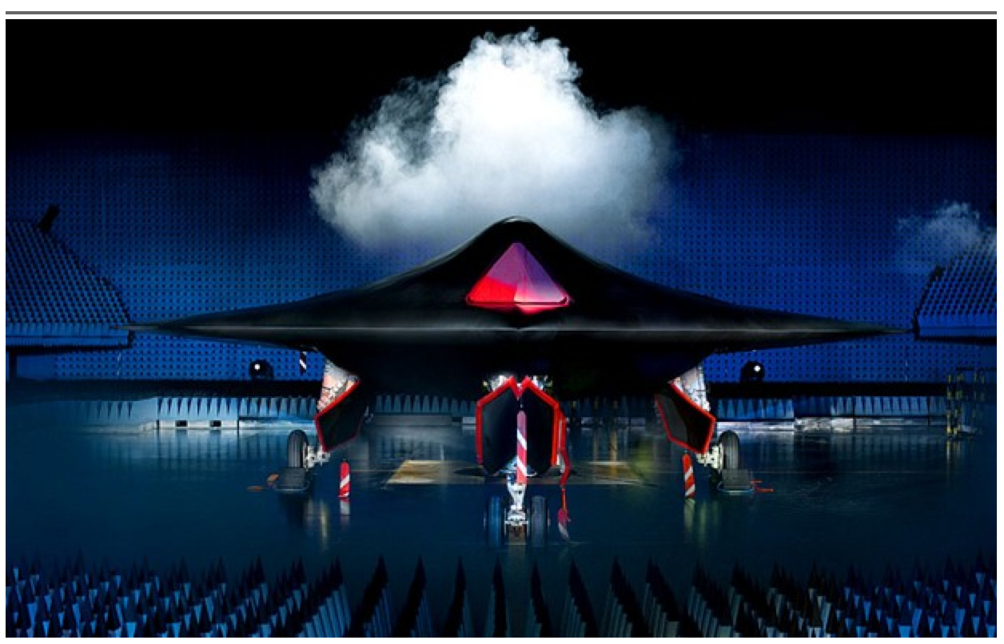

Slide 42
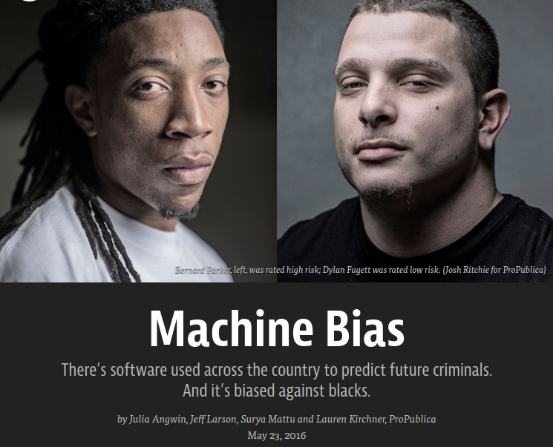

Slide 43
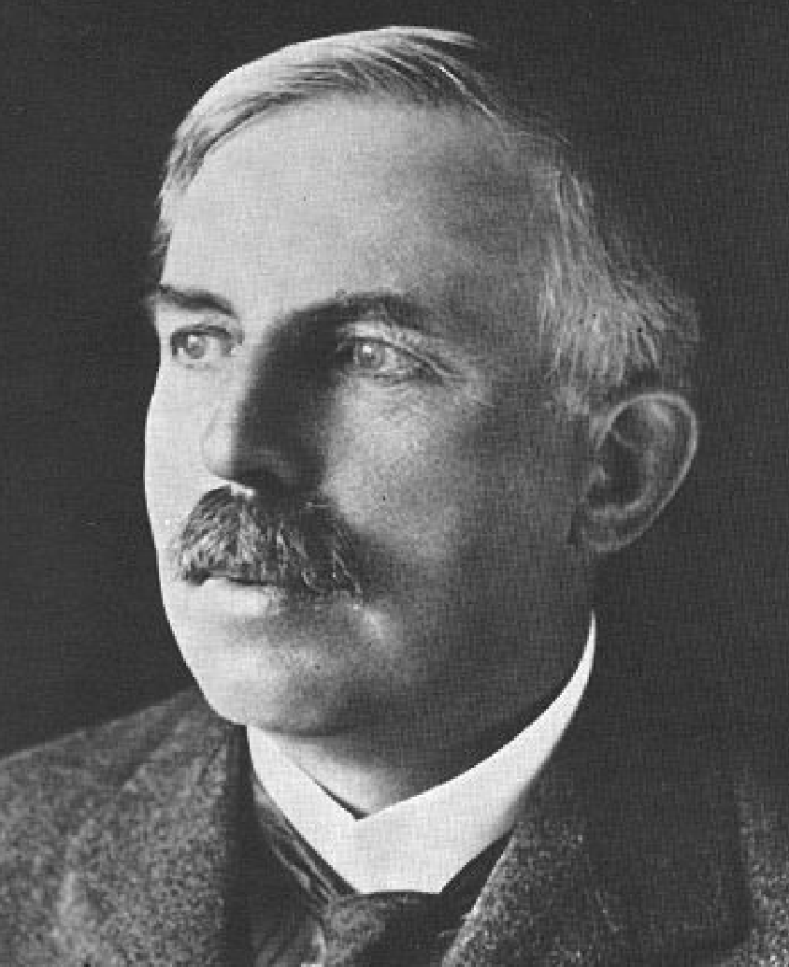
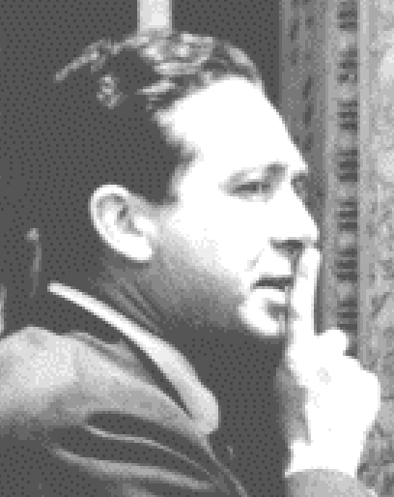
It’ll never happen
Sept 11, 1933: Lord Rutherford addressed BAAS: “Anyone who looks for a source of power in the transformation of the atoms is talking moonshine.”
Sept 12, 1933: Leo Szilard invented neutron-induced nuclear chain reaction
“We switched everything off and went home. That night, there was very little doubt in my mind that the world was headed for grief.”
[Stuart Russell]

Slide 44
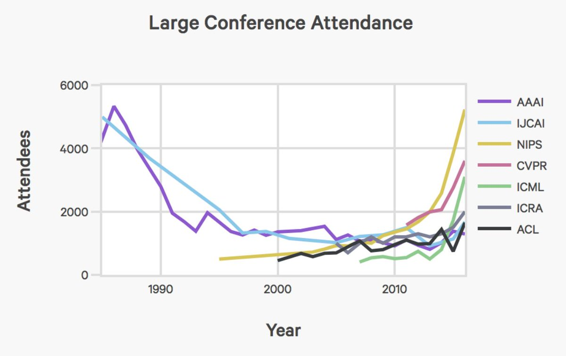
The Hype Cycle

